Slide 1
Investor Pitch Deck: Project Bento – A Desktop-First Covenant Command Center for the Modern Loan Market
Innovative financial technology addressing evolving loan market needs
Notes:
AI-generated content may be incorrect. --- Welcome to the investor pitch for Project Bento, a cutting-edge covenant command center designed specifically for the evolving loan market. This presentation will cover market challenges, our innovative solution, product design, go-to-market strategy, and growth potential.

Slide 2
Today's Agenda
Market Opportunity and Problem Statement
Solution Overview: Project Bento
Product Design and Technology
Go-to-Market Strategy and Business Model
Commercial Viability and Growth Potential
Notes:
Today, we will explore five key areas: the market opportunity and problem statement, an overview of Project Bento solution, product design and technology, our go-to-market strategy and business model, and finally, commercial viability and growth potential.

Slide 3
Market Opportunity and Problem Statement
Notes:
Understanding the current dynamics and challenges of the loan market is critical. We will outline the pain points faced by loan agency officers and highlight the gaps in existing monitoring solutions that Project Bento aims to address.

Slide 4

Rearview Mirror
Loan Officers currently rely on static spreadsheets that only show data after the quarter ends.
(The Risk)
Reactive monitoring leads to avoidable defaults because breaches are discovered too late.
The Privacy Gap
Banks cannot upload sensitive borrower PDFs to public cloud dashboards due to strict data compliance.
Regulatory Requirements
Stricter regulatory demands require real-time data accuracy and compliance management in loan processing.
Notes:
--- The loan market is increasingly complex, with growing regulatory requirements and the need for real-time data. Current systems often lack integration, agility, and user-centric design leading to inefficiencies in loan management. Image source: Microsoft 365 content library

Slide 5

Rearview Mirror
Fragmented Data Challenges
Loan Officers currently rely on static spreadsheets that only show data after the quarter ends.
Reactive Monitoring
Agents often discover covenant breaches weeks after they happen, leading to avoidable defaults.
Slow Response Times
Delayed processing and slow communication hinder timely portfolio management and decision-making.
Privacy Risks
Uploading sensitive borrower documents to public cloud dashboards violates strict bank data policies.
Notes:
--- Loan agency officers face challenges such as fragmented data, manual monitoring processes, and slow response times. These pain points reduce operational efficiency and increase risk exposure for portfolio management. Image source: Microsoft 365 content library

Slide 6
Gap in Existing Monitoring Solutions
Outdated Technology
Current monitoring tools rely on obsolete technology that limits performance and user experience.
Lack of Desktop Compatibility
Many solutions are not compatible with desktop environments, hindering accessibility and usability.
Insufficient Functionality
Existing tools lack comprehensive features necessary for seamless and effective monitoring.
Notes:
--- Existing covenant monitoring tools are often outdated, desktop-incompatible, or lack comprehensive functionality, leaving a significant gap in user needs for a seamless and effective solution. Image source: Microsoft 365 content library

Slide 7
Solution Overview: Project Bento
Notes:
Project Bento is designed to bridge these gaps by offering a desktop-first, comprehensive covenant command center. Let’s look into its unique value proposition, key features, and how it modernizes portfolio health monitoring.

Slide 8
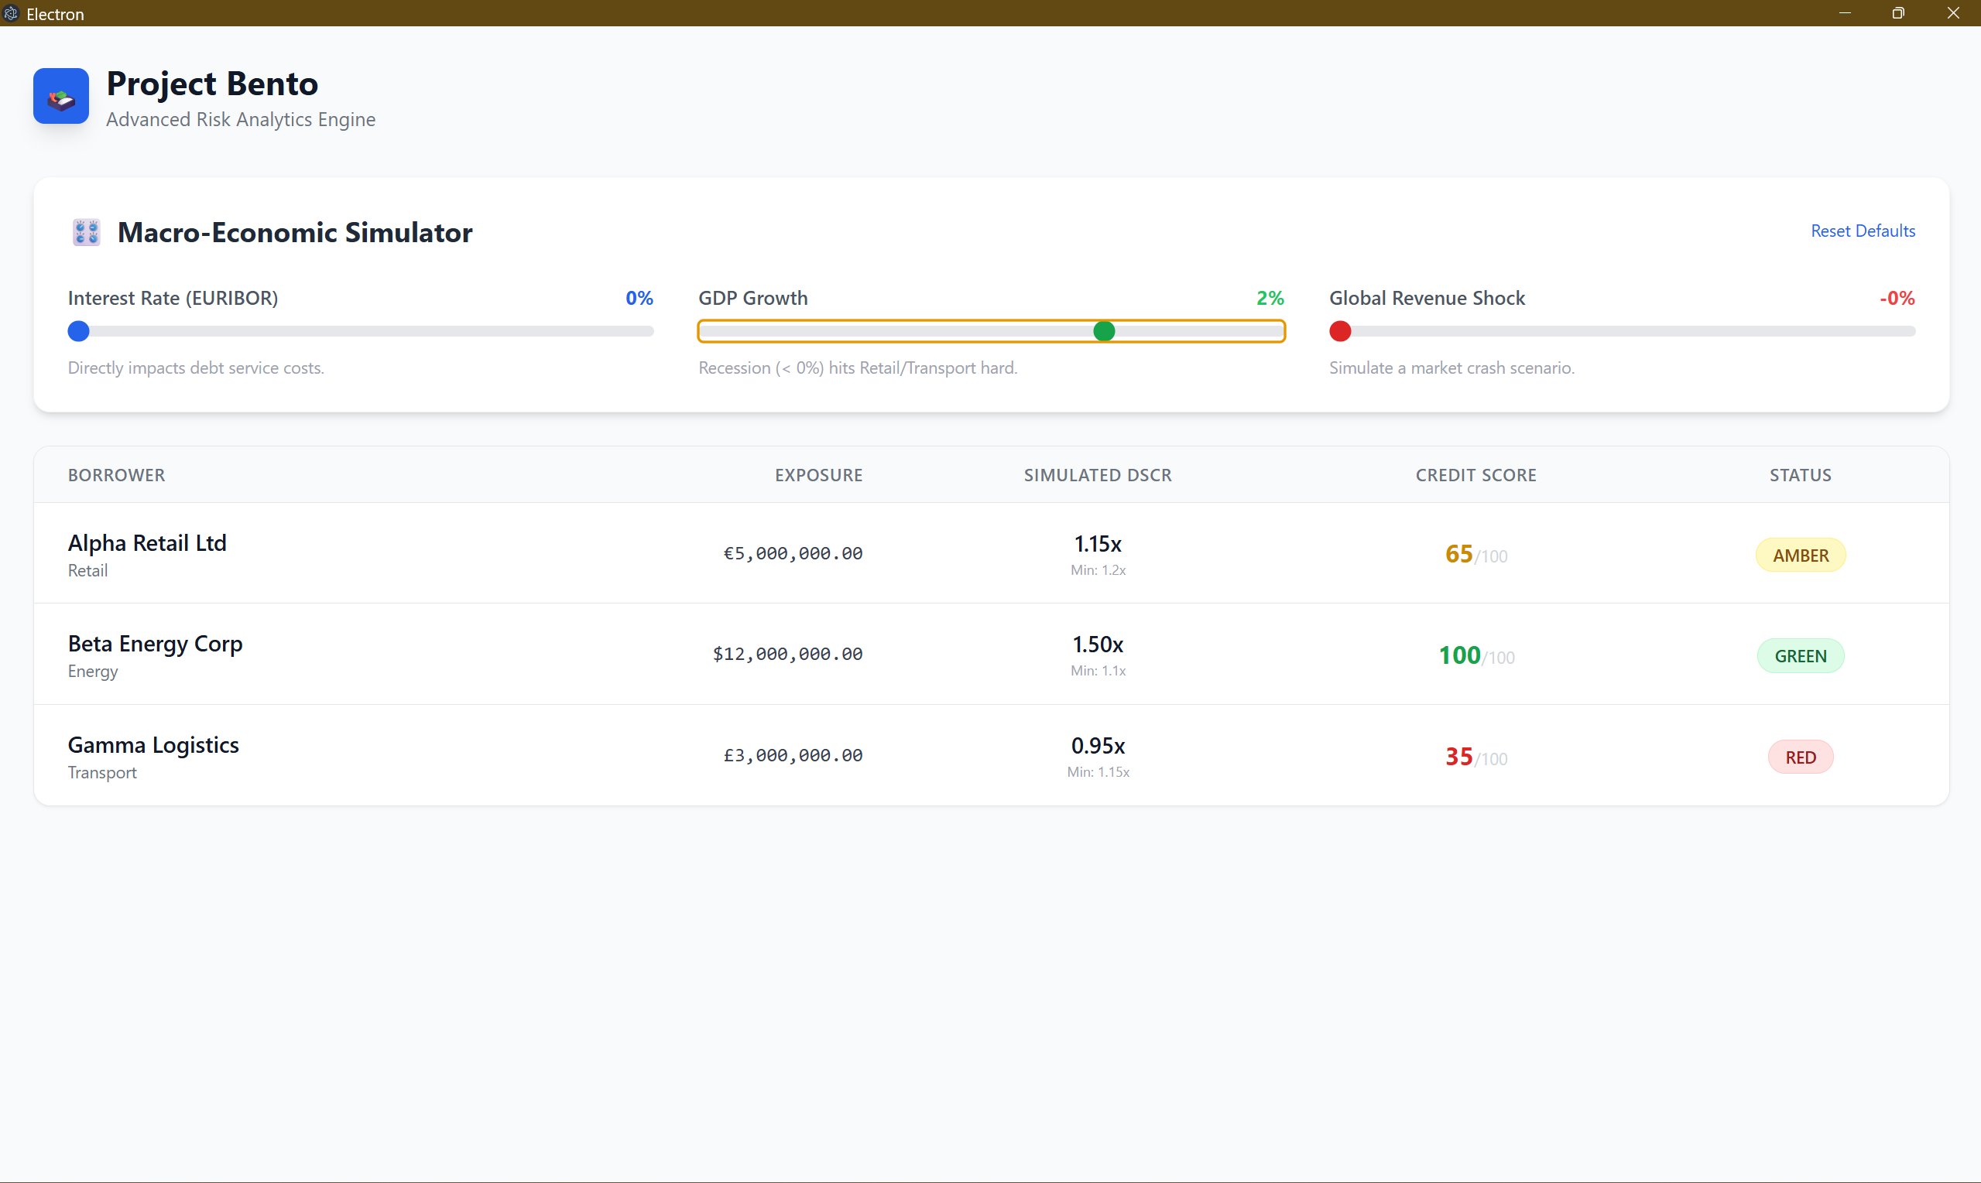
Project Bento: The Proactive Covenant Command Center.
Multivariate Risk Engine
A 10-factor algorithm that calculates composite credit scores in real-time.
"What-If" Stress Testing
Instantly simulates Interest Rate hikes (EURIBOR/SOFR) and GDP shocks to predict defaults before they occur.
Traffic Light System
Visual Red/Amber/Green indicators for immediate portfolio health assessment.
Notes:
--- Project Bento integrates advanced analytics and real-time monitoring in an intuitive desktop interface tailored to loan agency officers, improving decision-making and operational efficiency in the loan market. Image source: Microsoft 365 content library

Slide 9
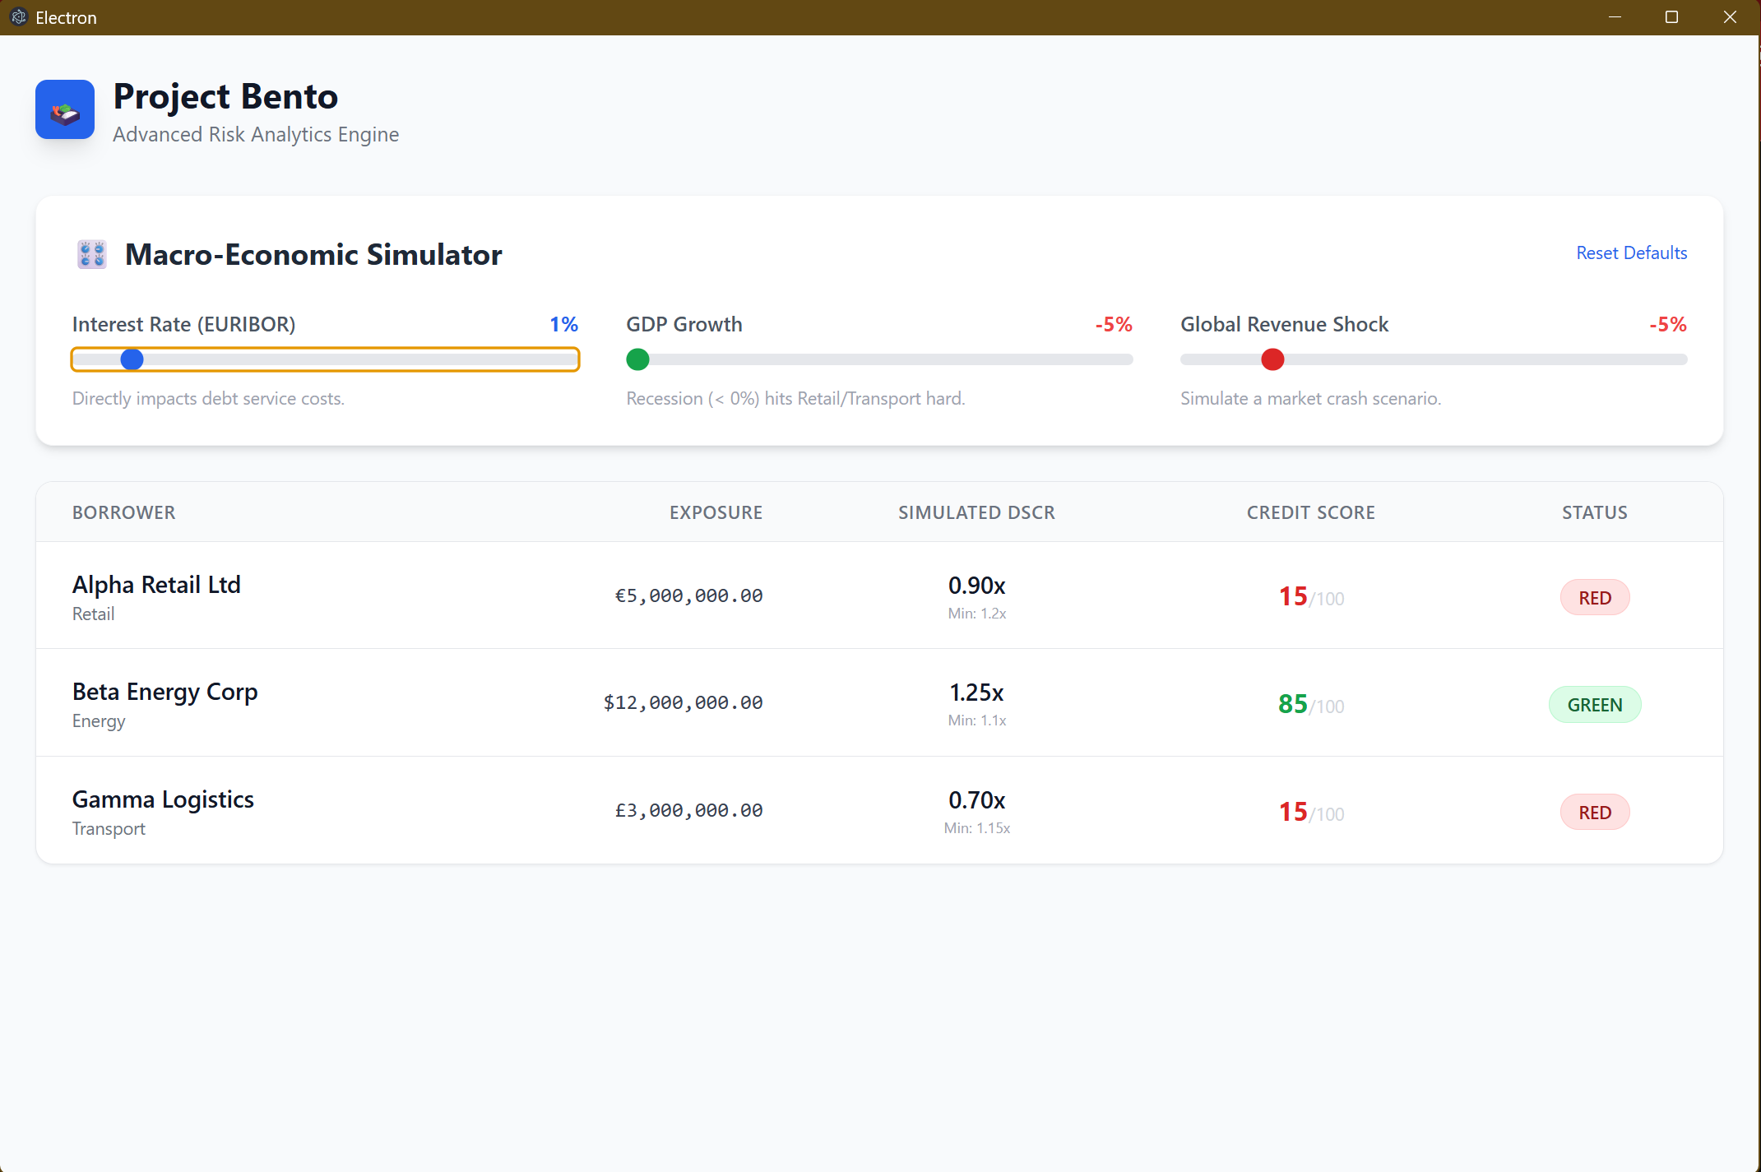
Project Bento: The Proactive Command Center
Automated Alerts
Automatically notifies users of covenant breaches or upcoming deadlines to enable prompt action.
Customizable Dashboards
Allows users to tailor dashboard views for personalized monitoring and reporting needs.
Seamless Integration
Integrates smoothly with existing loan management platforms for comprehensive covenant oversight.
Notes:
--- Key features include real-time covenant compliance tracking, automated alerts, customizable dashboards, and seamless integration with existing loan management platforms to provide comprehensive oversight. Image source: Microsoft 365 content library

Slide 10
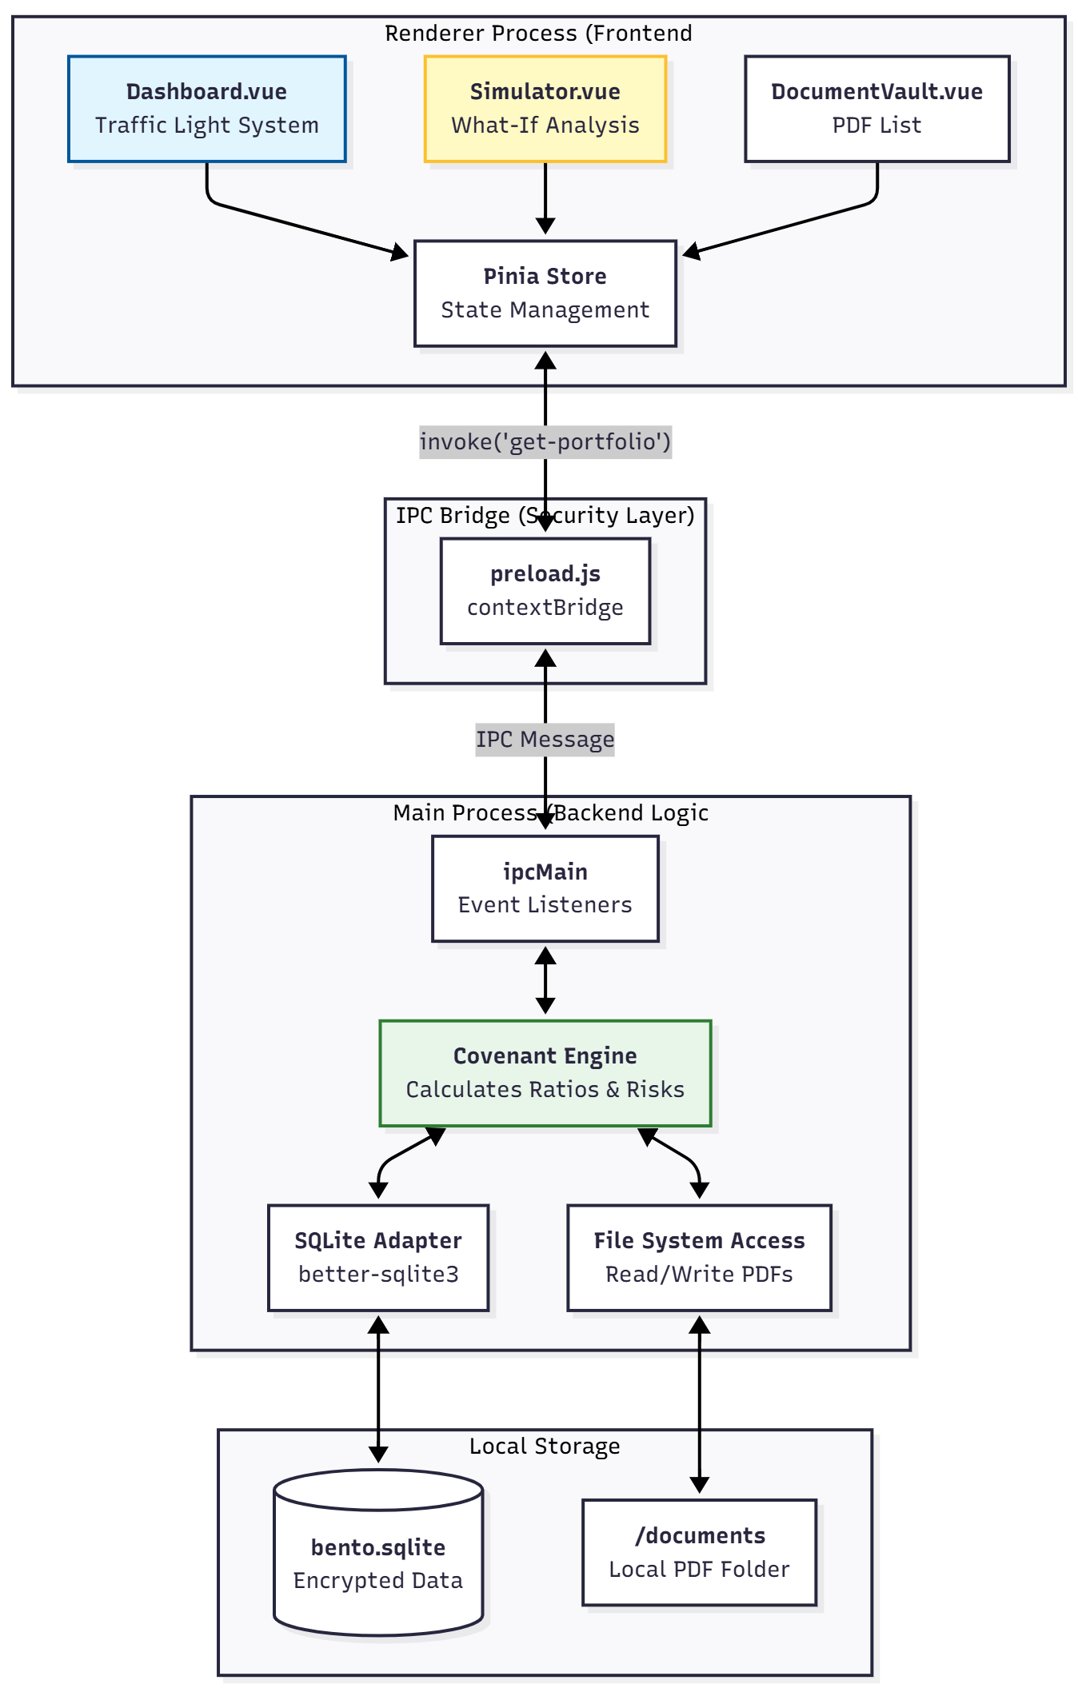
How Project Bento Modernizes Portfolio Health Monitoring
Streamlined Portfolio Checks
Project Bento simplifies portfolio health assessments by automating manual processes, improving efficiency and accuracy.
Reduced Manual Effort
By minimizing manual tasks, Project Bento frees up time for strategic decision-making and reduces human error.
Enhanced Risk Mitigation
Data-driven insights enable better risk management and proactive portfolio adjustments to safeguard investments.
Notes:
--- By leveraging modern technology, Project Bento streamlines portfolio health checks, reduces manual effort, and enhances risk mitigation through precise, data-driven insights. Image source: Microsoft 365 content library

Slide 11
Product Design and Technology
Notes:
We emphasize a desktop-first approach for optimal user experience, robust technology stack, and strong security measures to meet compliance and scalability needs.

Slide 12
Secure, Local-First Architecture.
Local Privacy Core
Built with SQLite embedded in Electron. Sensitive borrower data never leaves the user's machine.
Reactive UI
Built with Vue.js and Pinia for millisecond-latency updates during stress tests.
LMA Standard Compliance
Data structures designed to map directly to Loan Market Association covenant definitions.
Notes:
--- Our user interface is designed specifically for desktop users, offering powerful visualization tools and an intuitive workflow that aligns with loan officers’ daily tasks. Image source: Microsoft 365 content library

Slide 13

Core Technology Stack and Integration Capabilities
Scalable Technology Stack
Project Bento uses a scalable and modular technology stack to support growth and adaptability.
Seamless Integration
The platform allows seamless integration with third-party loan management software and data providers.
Ensured Interoperability
Ensures interoperability between various software systems to streamline workflows and data exchange.
Notes:
--- Project Bento is built on a scalable and modular technology stack allowing seamless integration with third-party loan management software and data providers, ensuring interoperability. Image source: Microsoft 365 content library

Slide 14

Security, Compliance, and Scalability
Enterprise-Grade Security
We implement robust security standards to protect sensitive enterprise data from breaches and cyber threats.
Data Privacy Compliance
Our solutions comply with evolving regulatory requirements to ensure user data privacy and legal adherence.
Scalable Architecture
We design scalable systems that efficiently support growing user bases and adapt to increasing workloads.
Notes:
--- We prioritize enterprise-grade security standards, data privacy compliance, and scalable architecture to support growing user bases and evolving regulatory requirements. Image source: Microsoft 365 content library

Slide 15
Go-to-Market Strategy and Business Model
Notes:
Our strategy focuses on identifying key market segments, establishing strong sales channels, and offering flexible pricing to accelerate adoption and revenue growth.

Slide 16

Target Customers and Market Segments
Loan Agency Officers
Loan agency officers coordinate between lenders and borrowers to manage loan agreements efficiently.
Lenders
Lenders provide financing and require tools to manage loan risk and portfolio health effectively.
Financial Institutions
Financial institutions handle complex loan portfolios, especially in mid-to-large market segments.
Notes:
--- Primary customers include loan agency officers, lenders, and financial institutions managing complex loan portfolios within mid-to-large markets. Image source: Microsoft 365 content library

Slide 17

Sales Channels and Partnership Opportunities
Direct Sales Approach
Utilizing direct sales to engage customers personally and drive immediate revenue growth.
Strategic Partnerships
Collaborating with loan management firms to expand market access and service offerings.
Industry Network Engagement
Leveraging established industry networks to increase brand visibility and customer acquisition.
Notes:
--- We plan to leverage direct sales, strategic partnerships with loan management firms, and industry networks to maximize reach and customer acquisition. Image source: Microsoft 365 content library

Slide 18
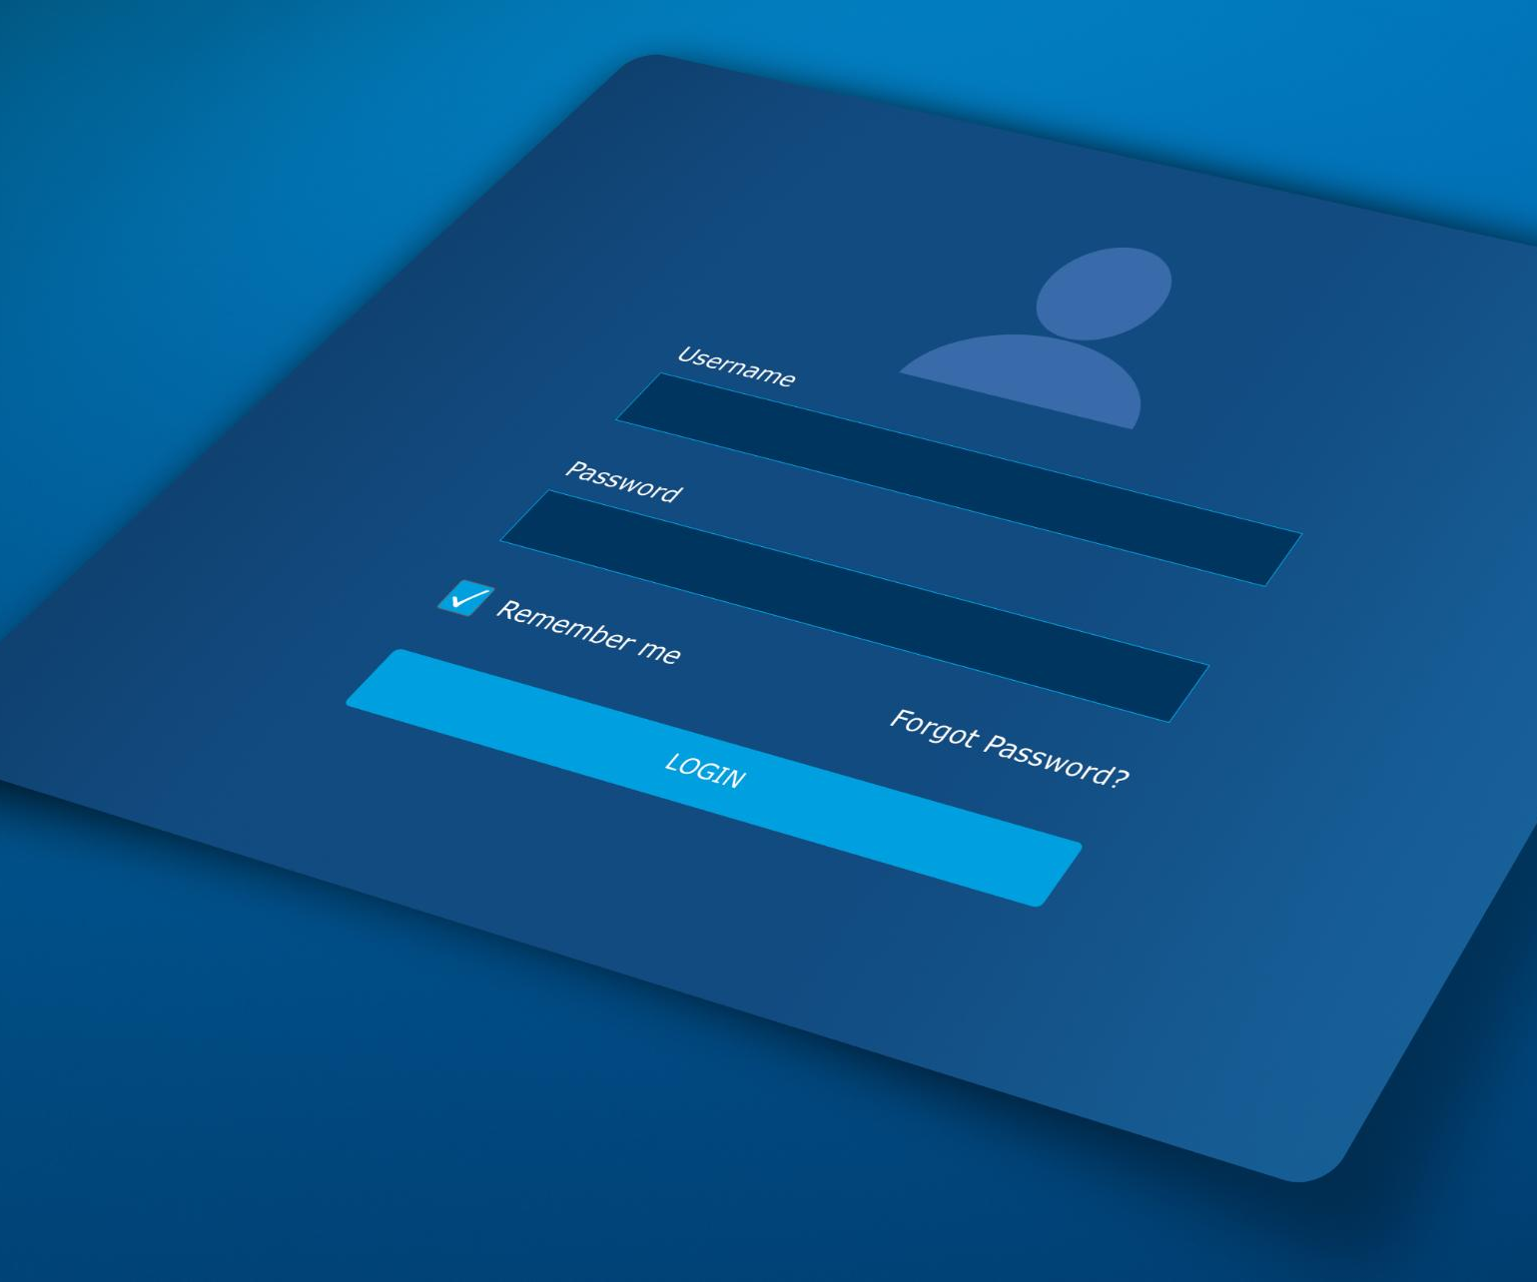
Preventing Defaults, Protecting Capital.
Early Warning System
By identifying "At-Risk" borrowers 3 months early, banks can restructure loans and avoid costly write-offs.
Operational Efficiency
Reduces manual spreadsheet checking time by 40%.
Zero-Integration Pilot
Because it's a desktop app (no cloud setup required), banks can pilot Bento immediately without complex IT procurement.
Notes:
--- Our revenue model is subscription-based, with tiered pricing plans aligned with user needs and feature access, ensuring predictable recurring revenue streams. Image source: Microsoft 365 content library

Slide 19
Commercial Viability and Growth Potential
Notes:
Finally, we will review our initial market traction, competitive advantages, and projections that illustrate strong potential returns for investors.

Slide 20

Initial Traction and Customer Validation
Strong User Engagement
Pilot programs showed high levels of user interaction and positive feedback with the product.
Customer Satisfaction Validation
User satisfaction confirms the value proposition and supports readiness for market growth.
Notes:
--- Early pilot programs have demonstrated strong user engagement and satisfaction, validating Project Bento’s value proposition and readiness for market expansion. Image source: Microsoft 365 content library

Slide 21

Competitive Landscape and Differentiation
Desktop-First Design
Project Bento prioritizes a desktop-first approach, ensuring optimal user experience on desktop platforms.
Comprehensive Feature Set
It offers a broad range of features that meet diverse user needs and enhance productivity.
Superior Integration
Project Bento seamlessly integrates with other tools, delivering unmatched connectivity and workflow efficiency.
Notes:
--- Project Bento distinguishes itself with a desktop-first design, comprehensive feature set, and superior integration capabilities that outperform existing solutions. Image source: Microsoft 365 content library

Slide 22

Growth Projections and Investor Returns
Market Share Growth
Projected expansion in market share indicates a strong competitive position and business growth.
Revenue Increase
Forecasted revenue growth suggests improved profitability and business scalability.
Attractive Investor Returns
Financial projections indicate significant returns, appealing to potential investors.
Notes:
--- Our financial forecasts indicate substantial growth in market share and revenue, offering attractive returns to investors over the next five years. Image source: Microsoft 365 content library

Slide 23
Conclusion
Transformative Opportunity
Project Bento offers a groundbreaking approach to revolutionize the loan market through innovative covenant monitoring.
Future of Portfolio Management
Join us in shaping the future of loan portfolio management with cutting-edge technology and insights.
Notes:
Project Bento represents a transformative opportunity in the loan market with its innovative approach to covenant monitoring. We invite you to join us in driving the future of loan portfolio management.

